Slide 1

Mobile App Development II COMP3097
Lecture 5
Przemyslaw Pawluk

Slide 2
Table of contents
Input UI components
Table
Touch events
Gestures

Slide 3
Input in iOS

Slide 4
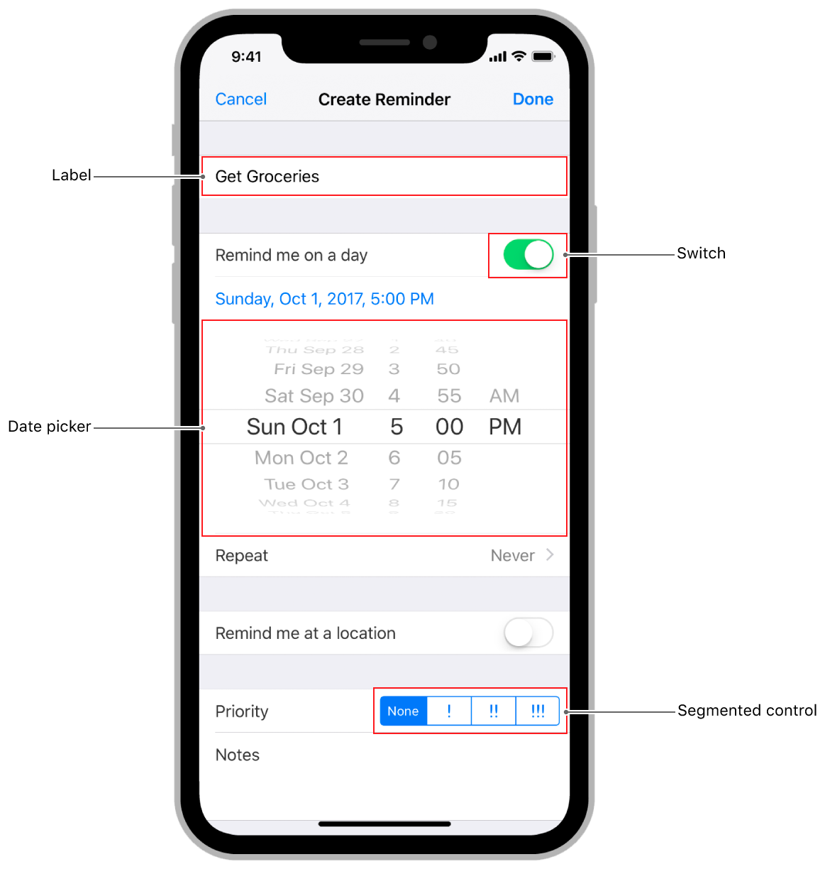

Slide 5
Simple input – Text Field
UITextField An object that displays an editable text area in your interface.
You use text fields to gather text-based input from the user using the onscreen keyboard. The keyboard is configurable for many different types of input such as plain text, emails, numbers, and so on. Text fields use the target-action mechanism and a delegate object to report changes made during the course of editing.
In addition to its basic text-editing behavior, you can add overlay views to a text field to display additional information and provide additional tappable controls. You might add custom overlay views for elements such as a bookmarks button or search icon. Text fields provide a built-in overlay view to clear the current text. The use of custom overlay views is optional.

Slide 6
Simple input – Text Field
After adding a text field to your interface, you configure it for use in your app. Configuration involves performing some or all of the following tasks:
Configure one or more targets and actions for the text field.
Configure the keyboard-related attributes of the text field.
Assign a delegate object to handle important tasks, such as:
Determining whether the user should be allowed to edit the text field’s contents.
Validating the text entered by the user.
Responding to taps in the keyboard’s return button.
Forwarding the user-entered text to other parts of your app.
Store a reference to the text field in one of your controller objects.

Slide 7
Showing and Hiding Keyboard
When a text field becomes first responder, the system automatically shows the keyboard and binds its input to the text field.
A text field becomes the first responder automatically when the user taps it. You can also force a text field to become the first responder by calling its becomeFirstResponder() method.
You might force a text field to become first responder when you require the user to enter some information.

Slide 8
Showing and Hiding Keyboard
You can ask the system to dismiss the keyboard by calling the resignFirstResponder() method of your text field. Usually, you dismiss the keyboard in response to specific interactions.
For example, you might dismiss the keyboard when the user taps the keyboard’s return key. The system can also dismiss the keyboard in response to user actions. Specifically, the system dismisses the keyboard when the user taps a new control that does not support keyboard input
More information: https://developer.apple.com/documentation/uikit/uitextfield

Slide 9
Simple input – Text View
UITextView supports the display of text using custom style information and also supports text editing. You typically use a text view to display multiple lines of text, such as when displaying the body of a large text document.
This class supports multiple text styles through use of the attributedText property. (iOS 6+) Setting a value for this property causes the text view to use the style information provided in the attributed string.
You can still use the font, textColor, and textAlignment properties to set style attributes, but those properties apply to all of the text in the text view.
It’s recommended that you use a text view—and not a UIWebView object—to display both plain and rich text in your app.

Slide 10
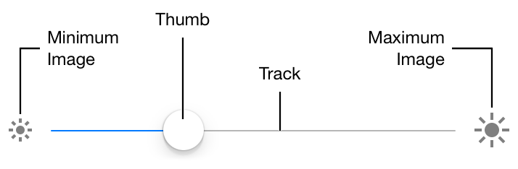
Slider: UISlider
As you move the thumb of a slider, it passes its updated value to any actions attached to it. The appearance of sliders is configurable; you can tint the track and the thumb, and provide images to appear at the ends of the slider. You can add sliders to your interface programmatically or by using Interface Builder.

Slide 11
Slider: responding to interactions
Sliders use the Target-Action design pattern to notify your app when the user moves the slider. To be notified when the slider’s value changes, register your action method with the valueChanged event. At runtime, the slider calls your method in response to the user changing the slider’s value.
By default, the slider sends value-changed events continuously as the user moves the slider’s thumb control. Setting the isContinuous property to false causes the slider to send an event only when the user releases the slider’s thumb control, setting the final value.

Slide 12
Slider: responding to interactions
You connect a slider to your action method by using the addTarget(_:action:for:) method or by creating a connection in Interface Builder. The signature of an action method takes one of three forms, which are shown in the listing. Choose the form that provides the information that you need to respond to the value change in the slider.
@IBAction func doSomething()
@IBAction func doSomething(sender: UISlider)
@IBAction func doSomething(sender: UISlider, forEvent event: UIEvent)

Slide 13
Slider: hints
Use either a custom tint color or a custom image, but not both.
When customizing slider appearance with images or tint, use one option or the other, but not both. Conflicting settings for track and thumb appearance are resolved in favor of the most recently set value. For example, setting a new minimum track image for any state clears any custom tint color you may have provided for minimum track images. Similarly, setting the thumb tint color removes any custom thumb images associated with the slider.

Slide 14
Slider: hints
The current value must be between the minimum and maximum values.
If you try to programmatically set a slider’s current value to be below the minimum or above the maximum, it is set to the minimum or maximum instead. However, if you set the value beyond the range of the minimum or maximum in Interface Builder, the minimum or minimum values are updated instead.

Slide 15
Slider: hints
Set custom images for all control states.
If you use custom track and thumb images for your slider, remember to set an image for every possible UIControl.State. Any control state that does not have a corresponding custom image assigned to it will display the standard image instead. If you set one custom image, be sure to set them all.

Slide 16
Switch
UISwitch A control that offers a binary choice, such as on/off.
The UISwitch class declares a property and a method to control its on/off state. As with UISlider, when the user manipulates the switch control (“flips” it), it triggers the valueChanged event.
You can customize the appearance of the switch by changing the color used to tint the switch when it is on or off.

Slide 17
Table View

Slide 18
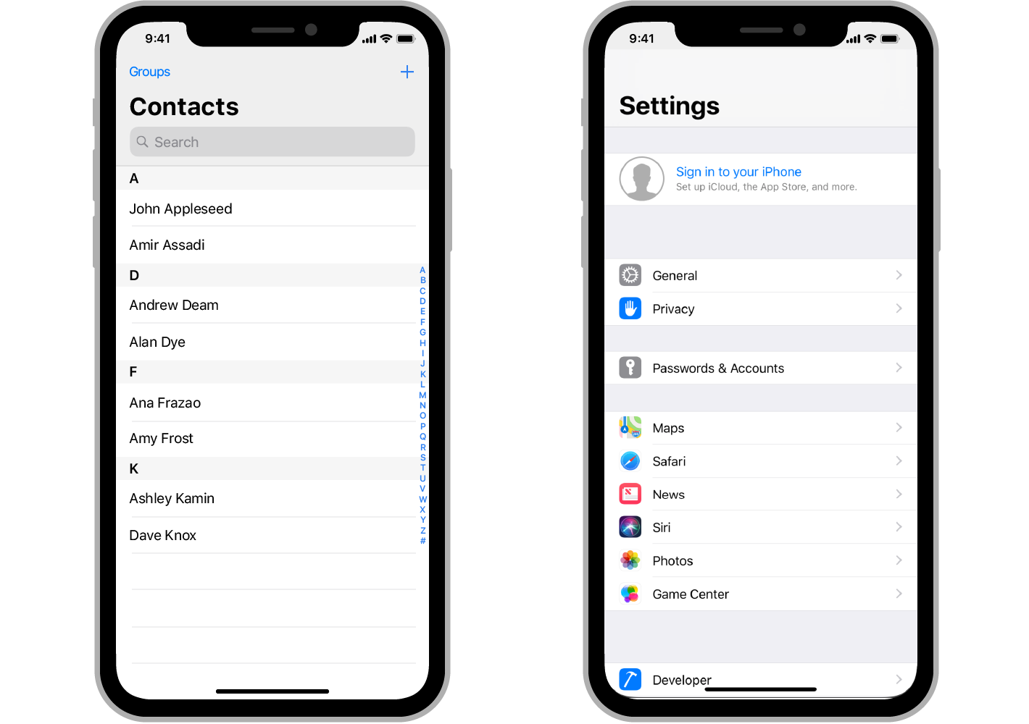

Slide 19
UITableView
Table views on iOS display a single column of vertically scrolling content, divided into rows. Each row in the table contains one piece of your app’s content.
For example, the Contacts app displays the name of each contact in a separate row, and the main page of the Settings app displays the available groups of settings.
You can configure a table to display a single long list of rows, or you can group related rows into sections to make navigating the content easier.

Slide 20
UITableView
Tables are commonly used by apps whose data is highly structured or organized hierarchically.
Apps that contain hierarchical data often use tables in conjunction with a navigation view controller, which facilitates navigation between different levels of the hierarchy.
UITableView manages the basic appearance of the table, but your app provides the cells (UITableViewCell objects) that display the actual content. The standard cell configurations display a simple combination of text and images, but you can define custom cells that display any content you want. You can also supply header and footer views to provide additional information for groups of cells.

Slide 21
UITableView
To add a table view to your interface, drag a Table View Controller (UITableViewController) object to your storyboard. Xcode creates a new scene that includes both the view controller and a table view, ready for you to configure and use.
Table views are data driven, normally getting their data from a data source object that you provide.
The data source object manages your app’s data and is responsible for creating and configuring the table’s cells. If the content of your table never changes, you can configure that content in your storyboard file instead.

Slide 22
Interactions
Taps and Gestures

Slide 23
Responders
Apps receive and handle events using responder objects. A responder object is any instance of the UIResponder class, and common subclasses include UIView, UIViewController, and UIApplication.
Responders receive the raw event data and must either handle the event or forward it to another responder object.
When your app receives an event, UIKit automatically directs that event to the most appropriate responder object, known as the first responder.
Unhandled events are passed from responder to responder in the active responder chain, which is the dynamic configuration of your app’s responder objects.

Slide 24
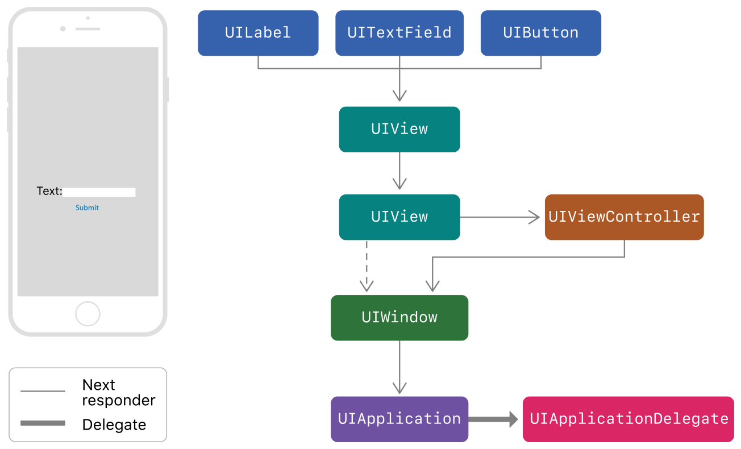
Responders
Notes:
This figure shows the responders in an app whose interface contains a label, a text field, a button, and two background views.
The diagram also shows how events move from one responder to the next, following the responder chain.

Slide 25
Finding responder
UIKit designates an object as the first responder to an event based on the type of that event. Event types include:
Event type | First responder
Touch events | The view in which the touch occurred.
Press events | The object that has focus.
Shake-motion events | The object that you (or UIKit) designate.
Remote-control events | The object that you (or UIKit) designate.
Editing menu messages | The object that you (or UIKit) designate.

Slide 26
Finding responder
Controls communicate directly with their associated target object using action messages.
When the user interacts with a control, it sends an action message to its target object.
Action messages are not events, but they may still take advantage of the responder chain.
When the target object of a control is nil, UIKit starts from the target object and traverses the responder chain until it finds an object that implements the appropriate action method.

Slide 27
Finding responder
Gesture recognizers receive touch and press events before their view does. If a view's gesture recognizers fail to recognize a sequence of touches, UIKit sends the touches to the view.
If the view does not handle the touches, UIKit passes them up the responder chain. For more information about using gesture recognizer’s to handle events, see Handling UIKit Gestures.

Slide 28
Gestures
Gesture recognizers are the simplest way to handle touch or press events in your views. You can attach one or more gesture recognizers to any view. Gesture recognizers encapsulate all of the logic needed to process and interpret incoming events for that view and match them to a known pattern. When a match is detected, the gesture recognizer notifies its assigned target object, which can be a view controller, the view itself, or any other object in your app.
Gesture recognizers use the target-action design pattern to send notifications. When the UITapGestureRecognizer object detects a single-finger tap in the view, it calls an action method of the view’s view controller, which you use to provide a response.

Slide 29
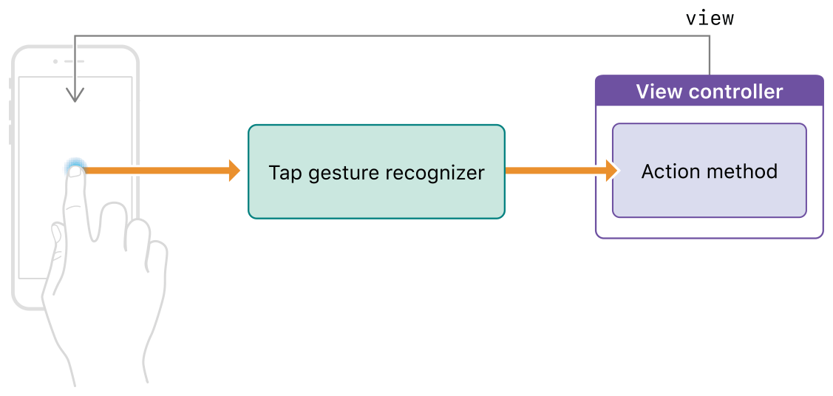
Gestures

Slide 30
Gestures
Gesture recognizers come in two types: discrete and continuous. A discrete gesture recognizer calls your action method exactly once after the gesture is recognized. After its initial recognition criteria are met, a continuous gesture recognizer performs calls your action method many times, notifying you whenever the information in the gesture's event changes.
Interface Builder includes objects for each of the standard UIKit gesture recognizers. It also includes a custom gesture recognizer object that you can use to represent your custom UIGestureRecognizer subclasses.

Slide 31
Gestures
To configure a gesture recognizer:
In your storyboard, drag the gesture recognizer onto your view.
Implement an action method to be called when the gesture is recognized.
Connect your action method to the gesture recognizer.
You can create this connection in Interface Builder by right-clicking the gesture recognizer and connecting its Sent Action selector to the appropriate object in your interface. You can also configure the action method programmatically using the addTarget(_:action:) method of the gesture recognizer.
@IBAction func myActionMethod(_ sender: UIGestureRecognizer)

Slide 32
Responding to gestures
The action method associated with a gesture recognizer provides your app’s response to that gesture.
For discrete gestures, your action method is similar to the action method for a button. Once the action method is called, you perform whatever task is appropriate for that gesture.
For continuous gestures, your action method can respond to the recognition of the gesture, but it can also track events before the gesture is recognized. Tracking events lets you create a more interactive experience.

Slide 33
Responder state
The state property of a gesture recognizer communicates the object’s current state of recognition. For continuous gestures, the gesture recognizer updates the value of this property
UIGestureRecognizer.State.began
UIGestureRecognizer.State.changed
UIGestureRecognizer.State.ended
or UIGestureRecognizer.State.cancelled
Notes:
https://developer.apple.com/documentation/uikit/touches_presses_and_gestures/handling_uikit_gestures

Slide 34

Questions

